Slide 1
Influential Women of the 21st Century
Minh Anh Nguyen

Slide 2
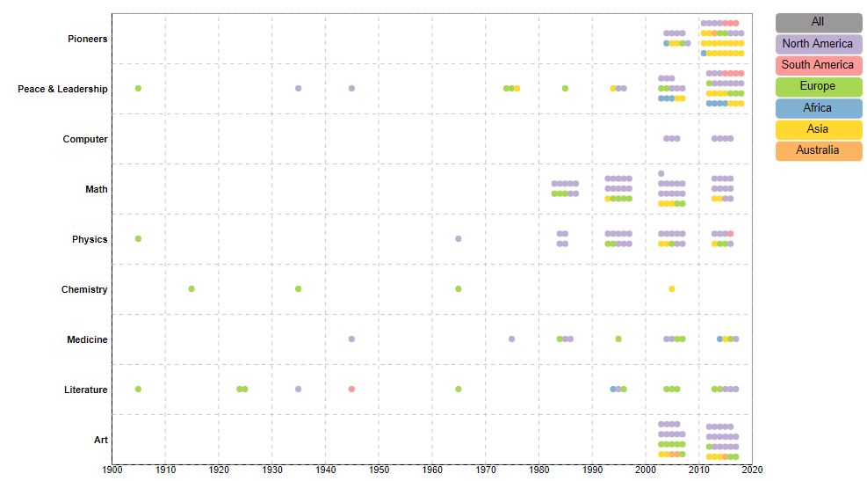
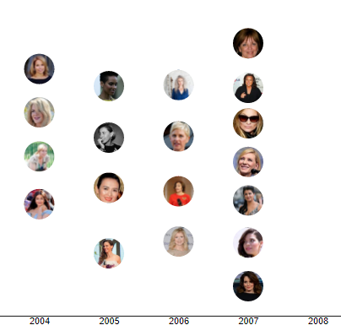
Project Description
Demonstrates the accomplishments of women from various regions of the worlds and in different fields through a scatter plot
Secondary plot of women in the same category and decade

Slide 3
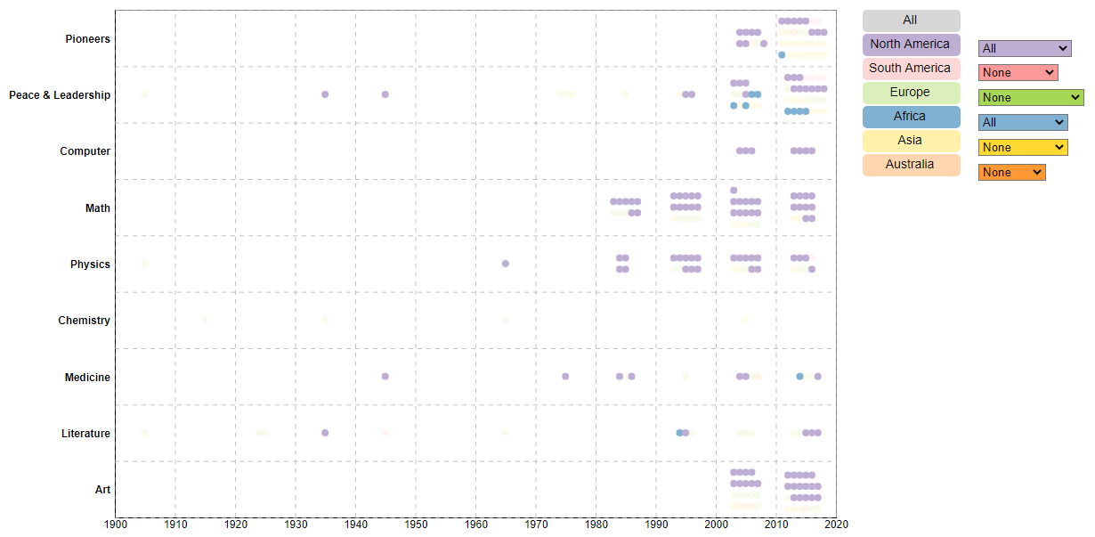
Class Enhancement Project Objective
Add functionality where users can compare the data between different continents and countries

Slide 4
Steps Taken
Updated project to D3 v5
Added more functionality to buttons so you can turn them on and off
Added drop down menu so users can compare the countries
Connected drop down menu and legend

